Slide 1
Trends in Single-use BIOPROCESSING 2D BAGS Analysis
Single-use Bags
April 2015
BioPlan Associates, Inc.
2275 Research Blvd, Suite 500
Rockville, MD 20850
301-921-5979
elanger@bioplanassociates.com
www.bioplanassociates.com

Slide 2
PROJECT OVERVIEW
As part of its ongoing evaluation of the bioprocessing industry, BioPlan Associates, Inc. reviewed single-use 2D bags, and their importance to bioprocessing.
This summary analysis is provided as a confidential review of this staple bioprocessing device to participants in this study.

Slide 3
summary of findings

Slide 4
Summary of findings
We evaluated current issues associated with 20L or smaller 2D bags currently being used in biopharmaceutical manufacturing.
We reviewed current trends, problems and potential improvements associated with these devices. The findings can be considered relevant to other ‘staple’ SUS devices.

Slide 5
Summary of findings
Respondents described issues and problems they typically see with their current 20L and smaller 2D. Problems included:
Looseness/breakage of connections
Poor positioning of ports
Lack of robustness
Leachables/Extractables
Supply chain issues
These issues have been quantified in prior studies. Here, we also assess the industry’s satisfaction with current product developments.

Slide 6
Summary of findings
We evaluated the need within the biopharma manufacturing industry for improvements in these common biomanufacturing devices.
Typically, respondents find current bags to be acceptable. But sought a variety of additional attributes, including:
Better freezing capabilities
Simpler handling/transport options
Better port locations

Slide 7
Summary of findings
Interest in better 2D bags was generally positive. However, there were few universally interesting or desired attributes.
Essentially, individual end-users seek individual, not easily categorized improvements.
As individual, incremental improvements few would be of very broad interest, but collectively, a ‘better’ bag technology would be seen as a step forward for SUS technologies.

Slide 8
Summary of findings
Another key finding regarding customization or individualization of 2D bags is that because most all large companies seek to standardize their materials usage, the more a device can be standardized, the better it may be accepted.
A more standardized device profile, and the availability of a full product line (sizes) would be useful to both large and small companies
Further, a more universal 2D bag design would be considered useful and cost-effective to end-users.

Slide 9
CONCLUSIONS
2D bags can be considered a staple of the bioprocessing industry. Most companies use these for a variety of applications.
Although some feel these devices are moving toward ‘commodity’ status, there is a need for improvements in product quality, performance and cost.

Slide 10
MACRO TRENDS IN BIOPHARMA
Notes:
Innovation fosters Leadership, fosters discussions.
Can Pall LS Sales Staff improve relationships for future R&D?

Slide 11
BIOPHARMA MARKET Growth: Defining Growth in Single-use Bioprocessing
Biopharma (drug) market >$165 billion/year
15% growth
Bioprocess supply (supplies to biopharma manufacturers) an $11 billion industry

Slide 12
FACILITY TRENDS
Multi-product facilities “Flexible Facilities”
Mostly single-use
More continuous processing
More focus on productivity
More interest in automation
More monitoring
More modeling

Slide 13
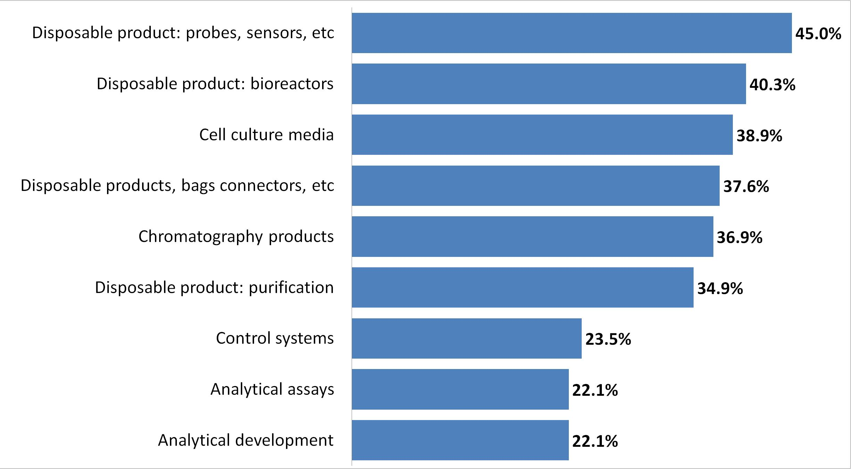
New Product Development Areas of Interest (suppliers to focus development on)
Source: 11th Annual Report and Survey of Biopharmaceutical Manufacturing Capacity and Productions, 2014

Slide 14
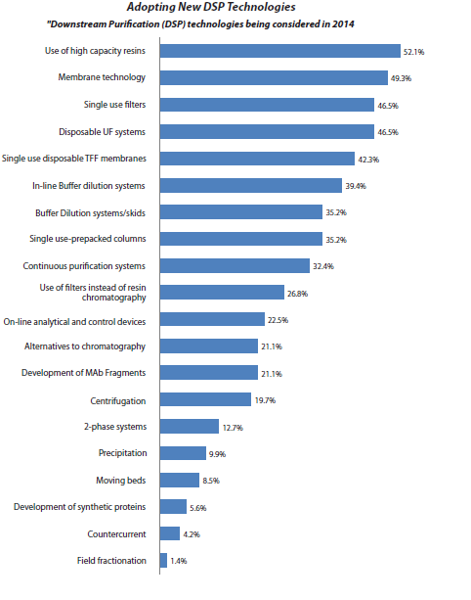
New Downstream processing solutions in 2014
Source: 11th Annual Report and Survey of Biopharmaceutical Manufacturing Capacity and Productions, 2014
Notes:
Industry
All devices increased innovation
SS is a legacy, nobody wants → Consideration for hybrid systems
Disposalbe purification is growing → it is our core competencies

Slide 15
New products demanded by BioPharma Top 4 of 21
Source: 11th Annual Report and Survey of Biopharmaceutical Manufacturing Capacity and Productions, 2014

Slide 16
Top New Technologies vendors working on 2011-2014
Source: 11th Annual Report and Survey of Biopharmaceutical Manufacturing Capacity and Productions, 2014

Slide 17
About BioPlan Associates, Inc.
Custom analysis, biopharma life sciences since 1989
Publications, annual reports, peer-reviewed studies
Commercialization programs
BioPlan Associates, Inc.
2275 Research Blvd, Suite 500
Rockville, MD 20850
www.bioplanassociates.com
301-921-5979

